Slide 1
Best
Practices
eBird Data Extraction and Processing in R
Notes:
Introduce instructors
Introduce participants: who you are, how you’re hoping to use eBird data (ok, if you’re just curious and don’t have any specific project in mind)

Slide 2
is a an online database of bird observations collected by citizen scientists, providing real-time data about the global distribution and abundance of bird species.
Notes:
Who’s submitted an eBird checklist?
Who’s tried to use eBird data before?

Slide 3
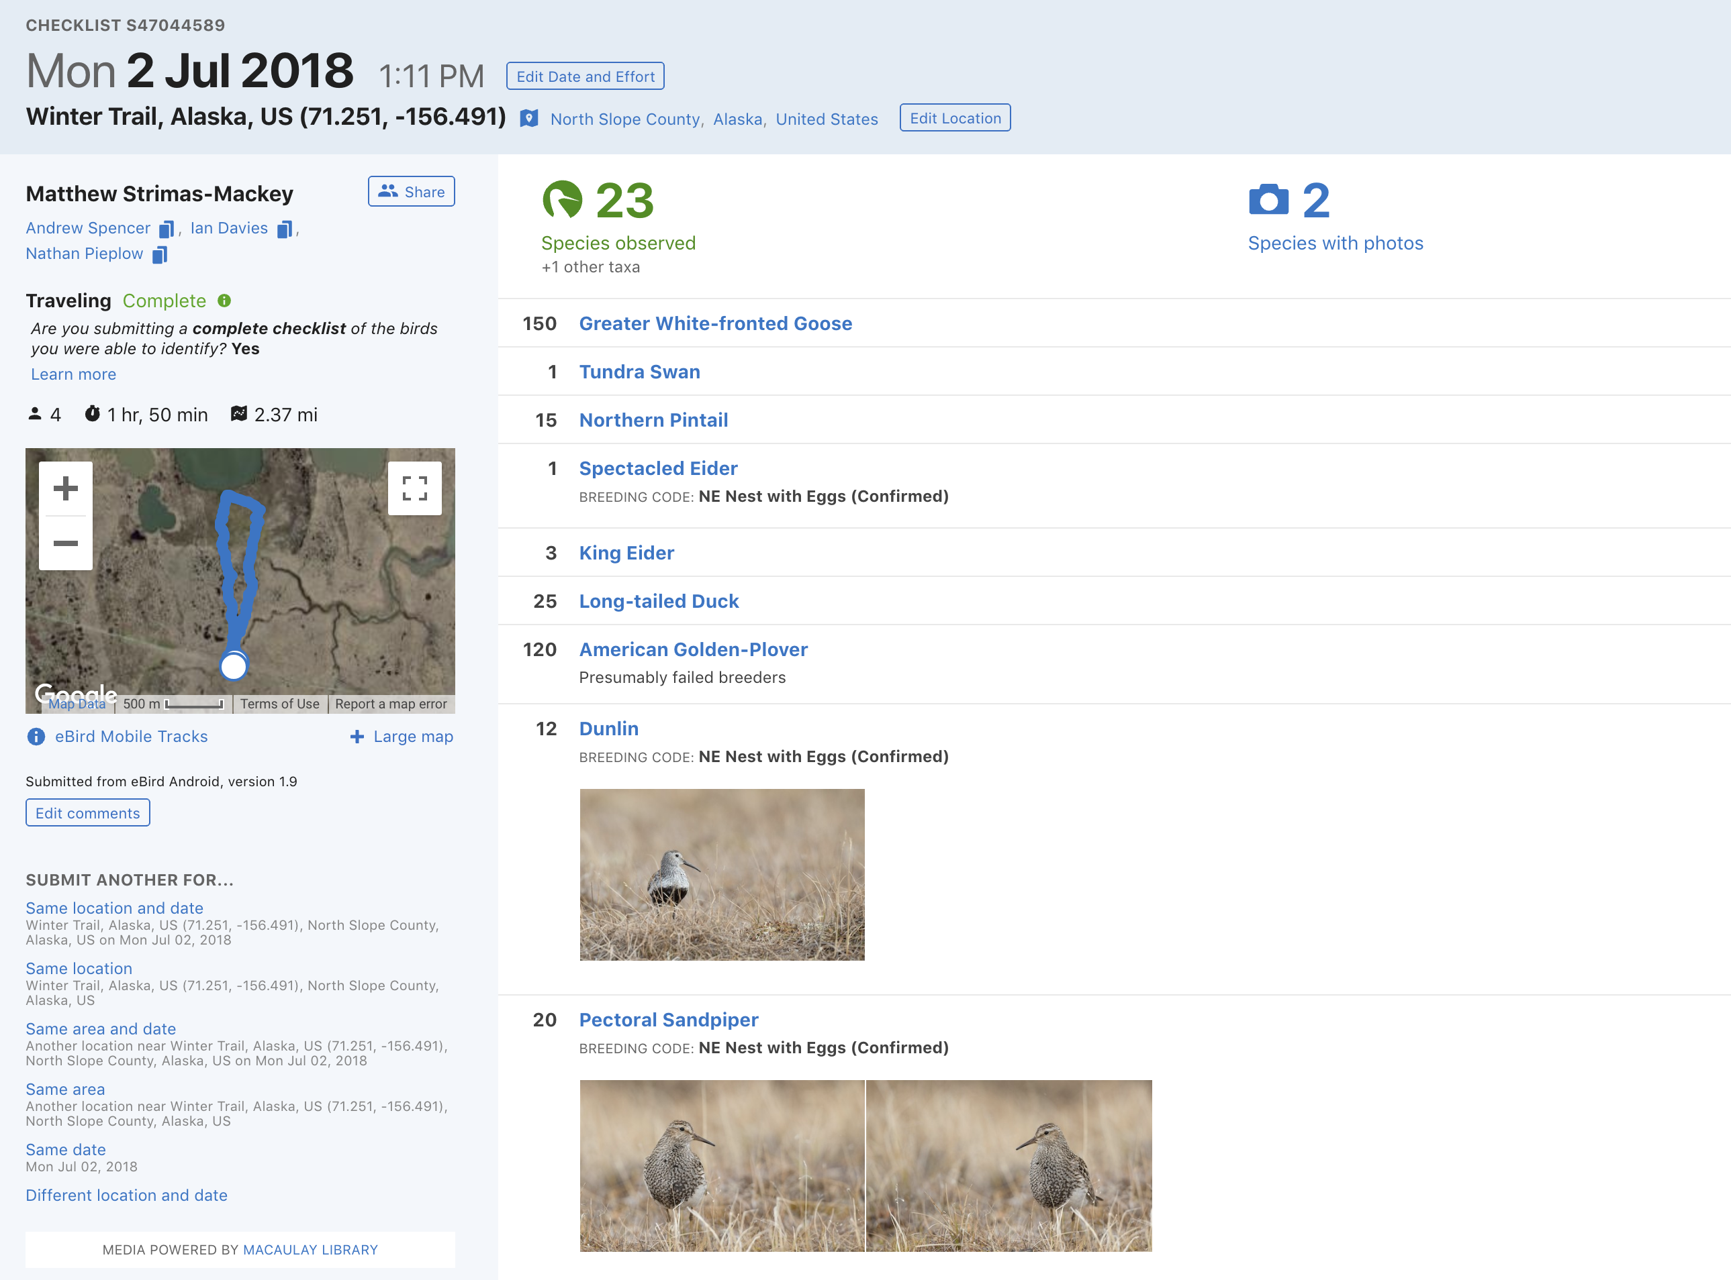
Notes:
All data in eBird is collected in the form of a checklist: a list of all species observed in a single birding event.
Contrast to iNaturalist

Slide 4
645 million observations
461,509 eBirders
eBird checklists per month (Thousands)
4,695 cumulative years of effort
10,419 species (98% of bird species)
Notes:
One of the largest repositories of biodiversity data

Slide 5
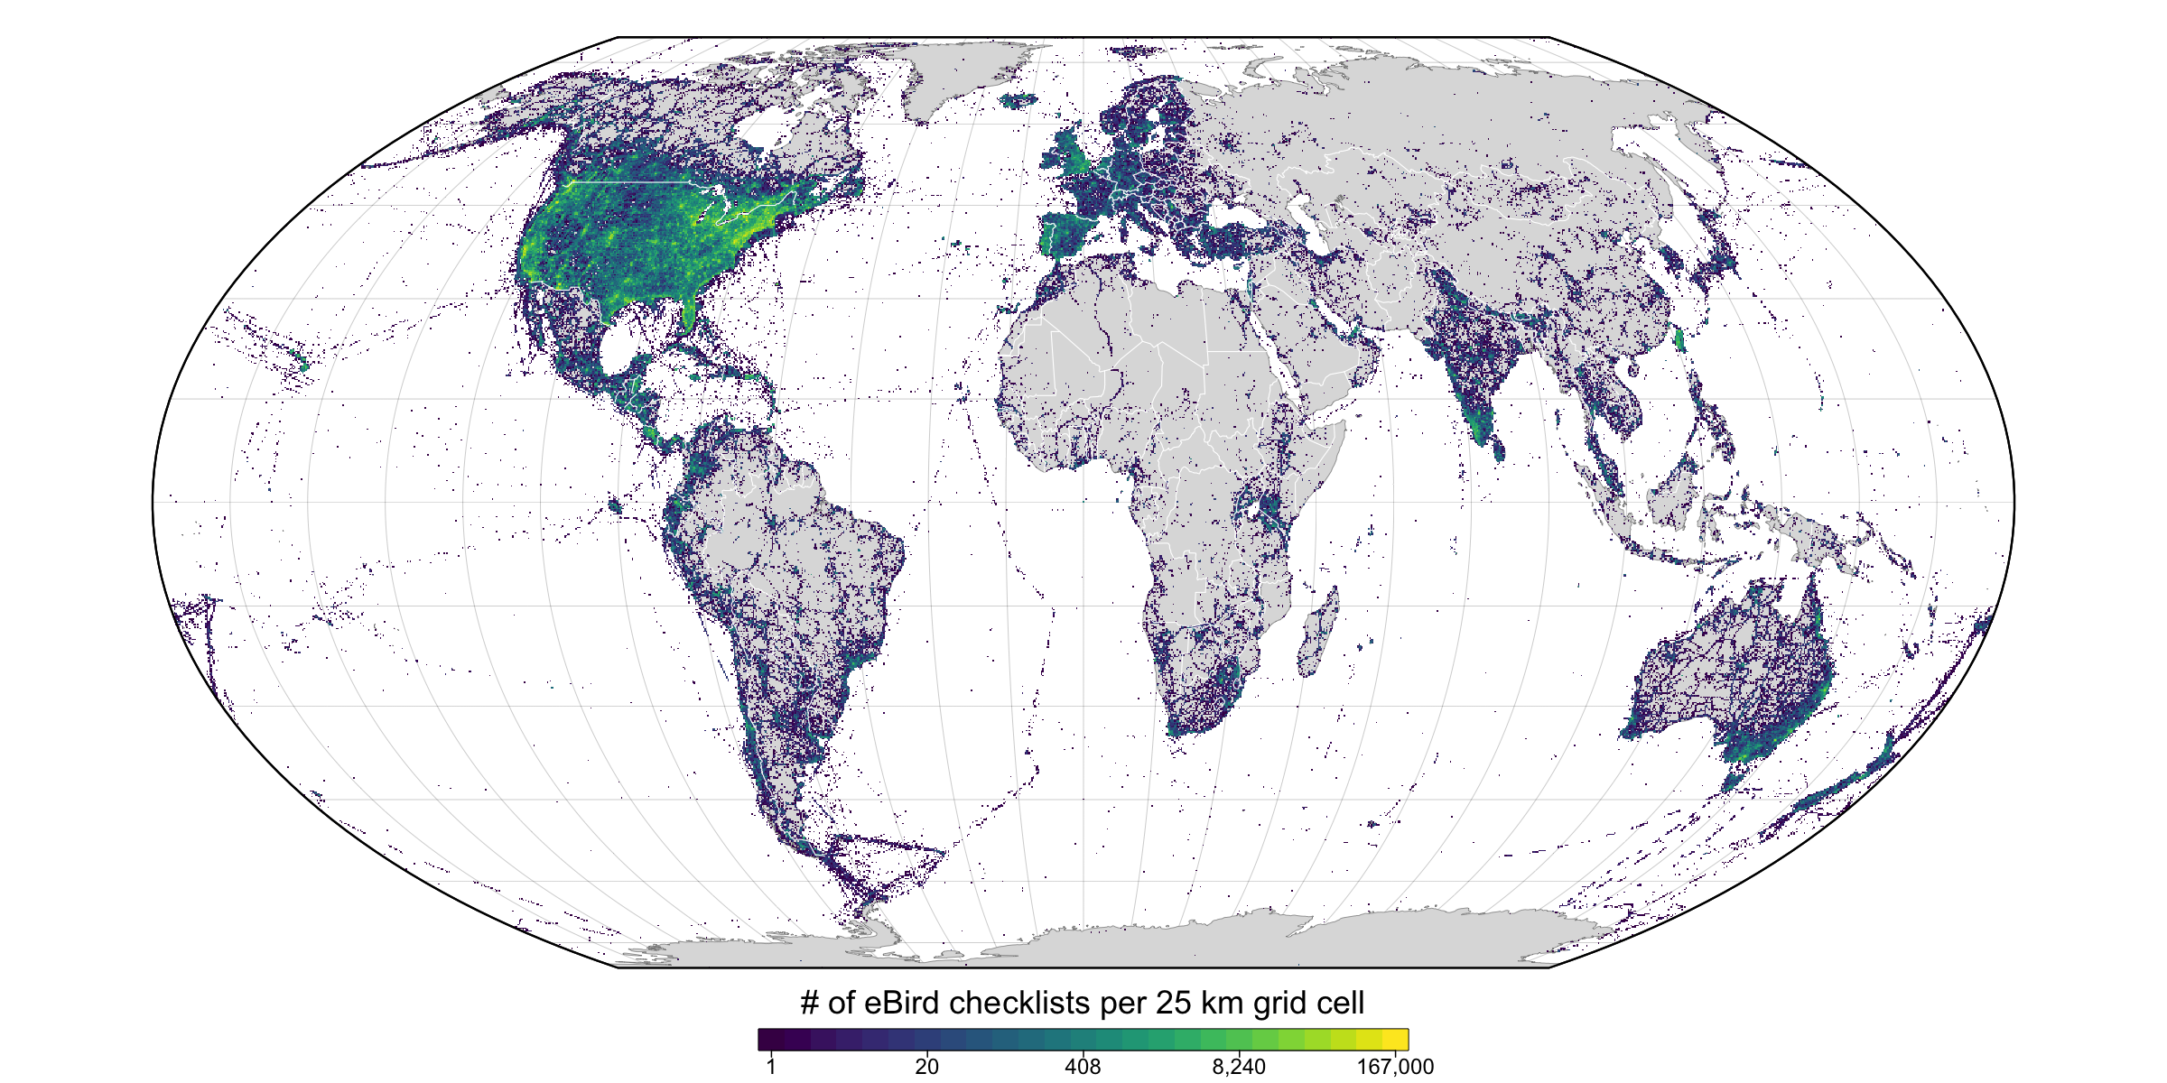
eBird checklists per 25 km grid cell
Notes:
eBird data are global in scope, this map depicts the number of checklists within 25 km grid cells, and you can see that every country on earth is represented in eBird.
eBird started in North America, before going global in 2010, and you can see there is still a strong US bias in eBird data

Slide 6
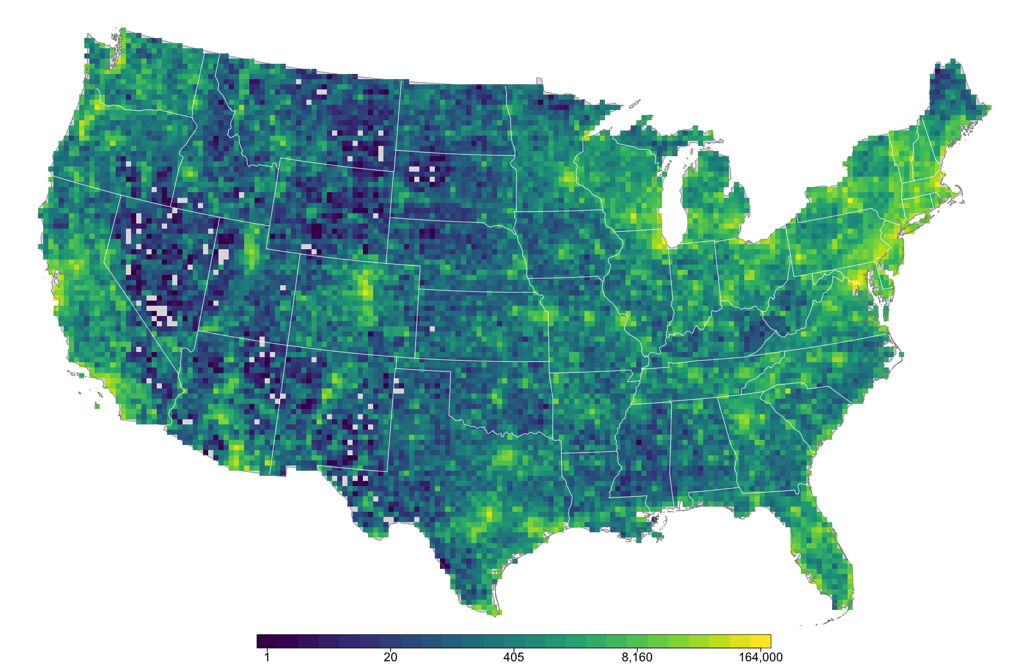

Slide 7
How do I access eBird data?
eBird website
1
eBird Status and Trends
2
Accessing raw eBird data
3
Notes:
Mention GBIF: a degraded form of eBird data, don’t use it because presence only and doesn’t include all fields

Slide 8
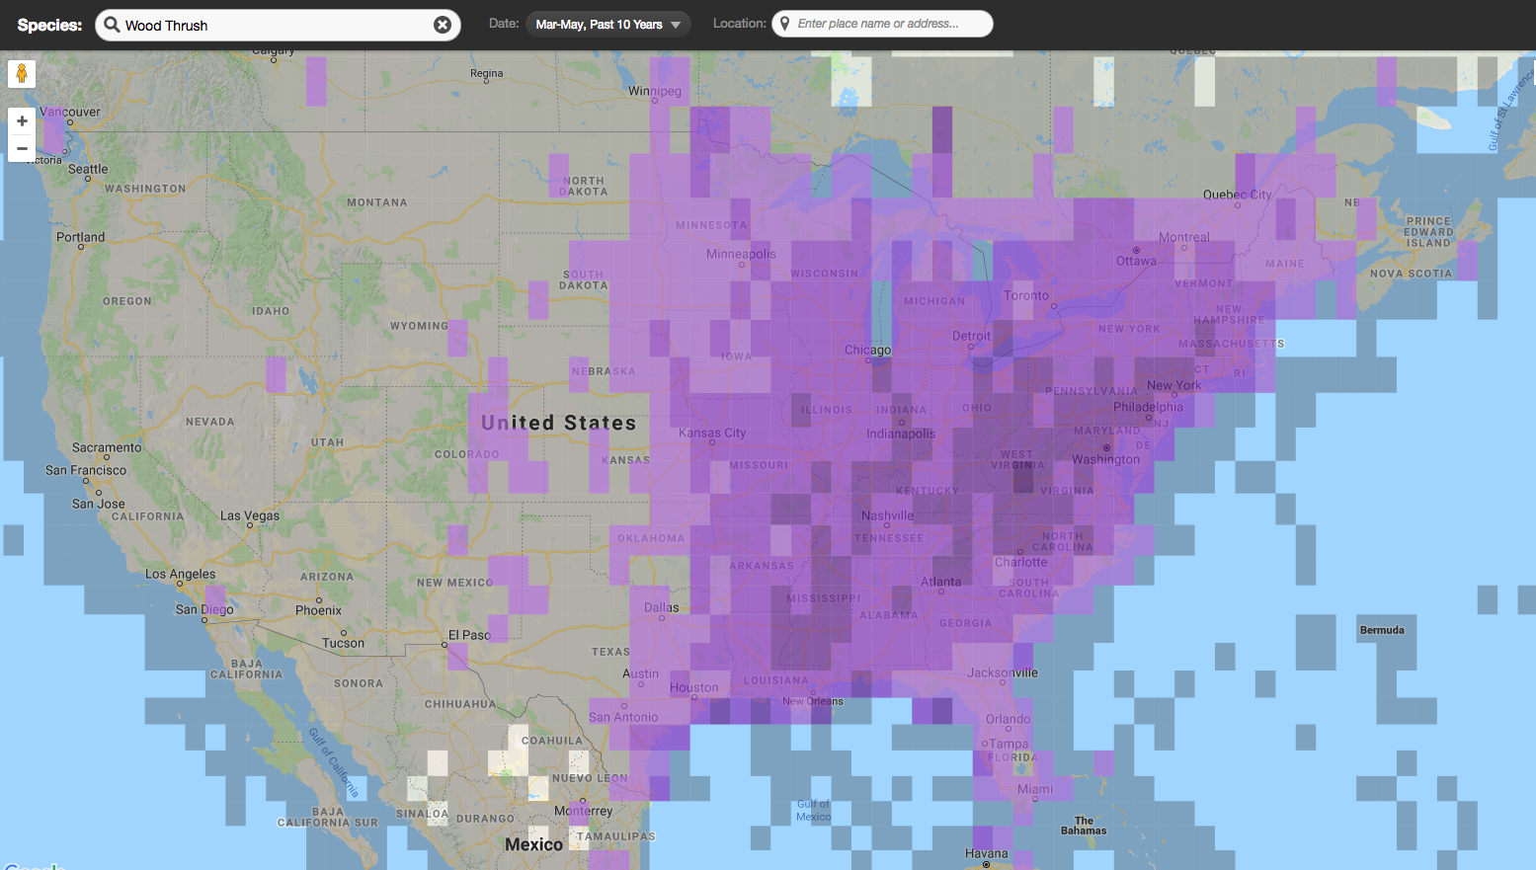
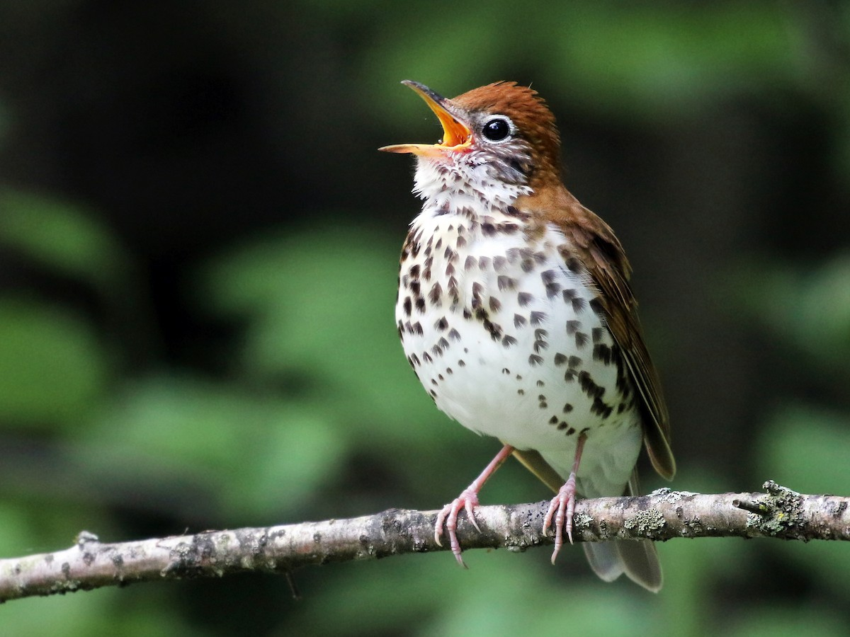
1
Notes:
The eBird website has all sorts of amazing tools for summarizing and visualizing eBird data, which can be super useful for exploratory analysis

Slide 9
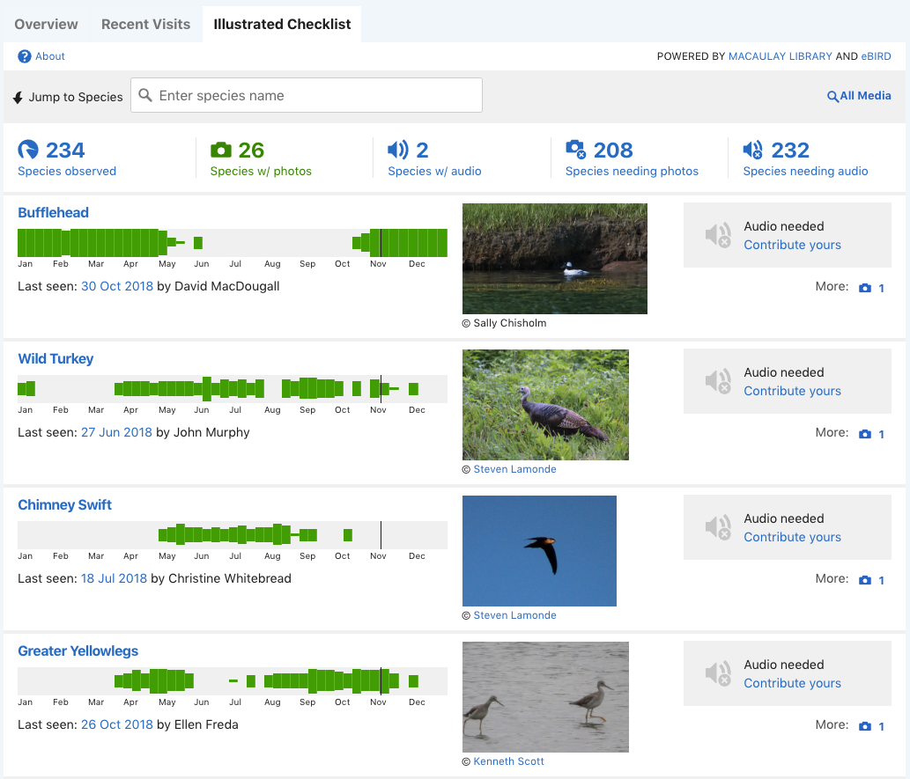
1

Slide 10
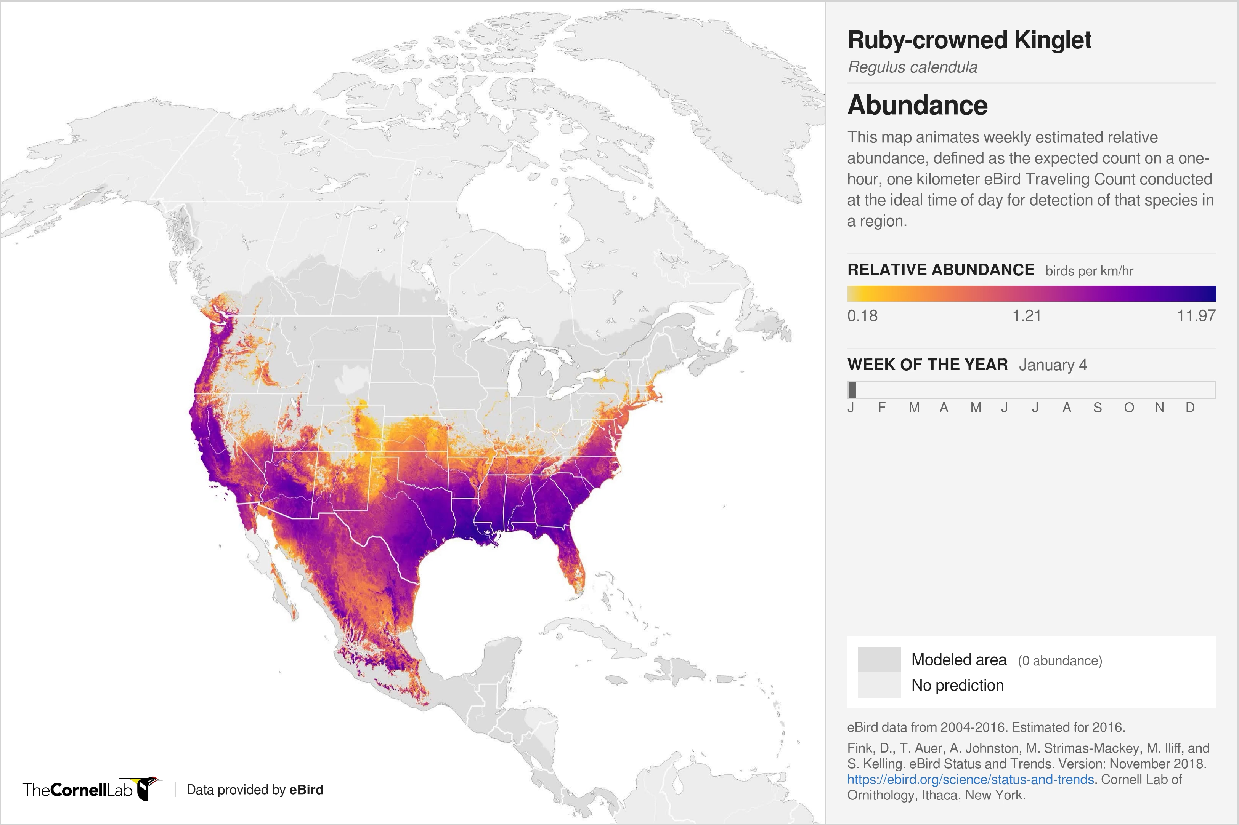
2
Full life cycle models, at high spatiotemporal resolution, of:
abundance
trends
habitat associations
range
Status & Trends

Slide 11
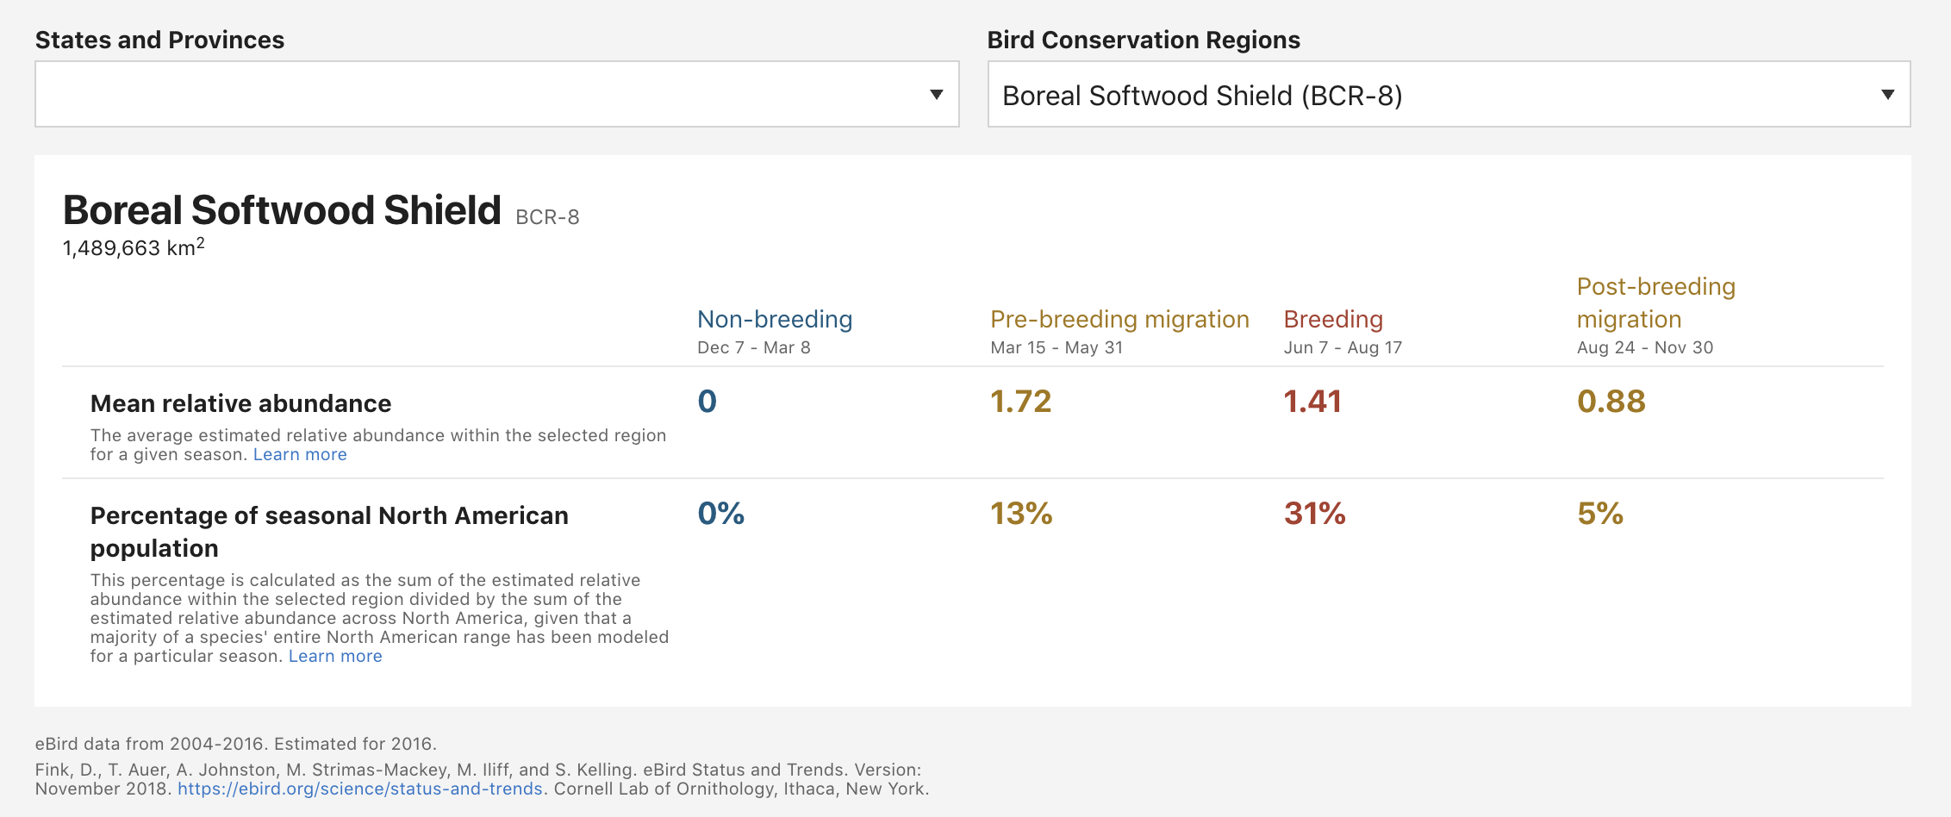
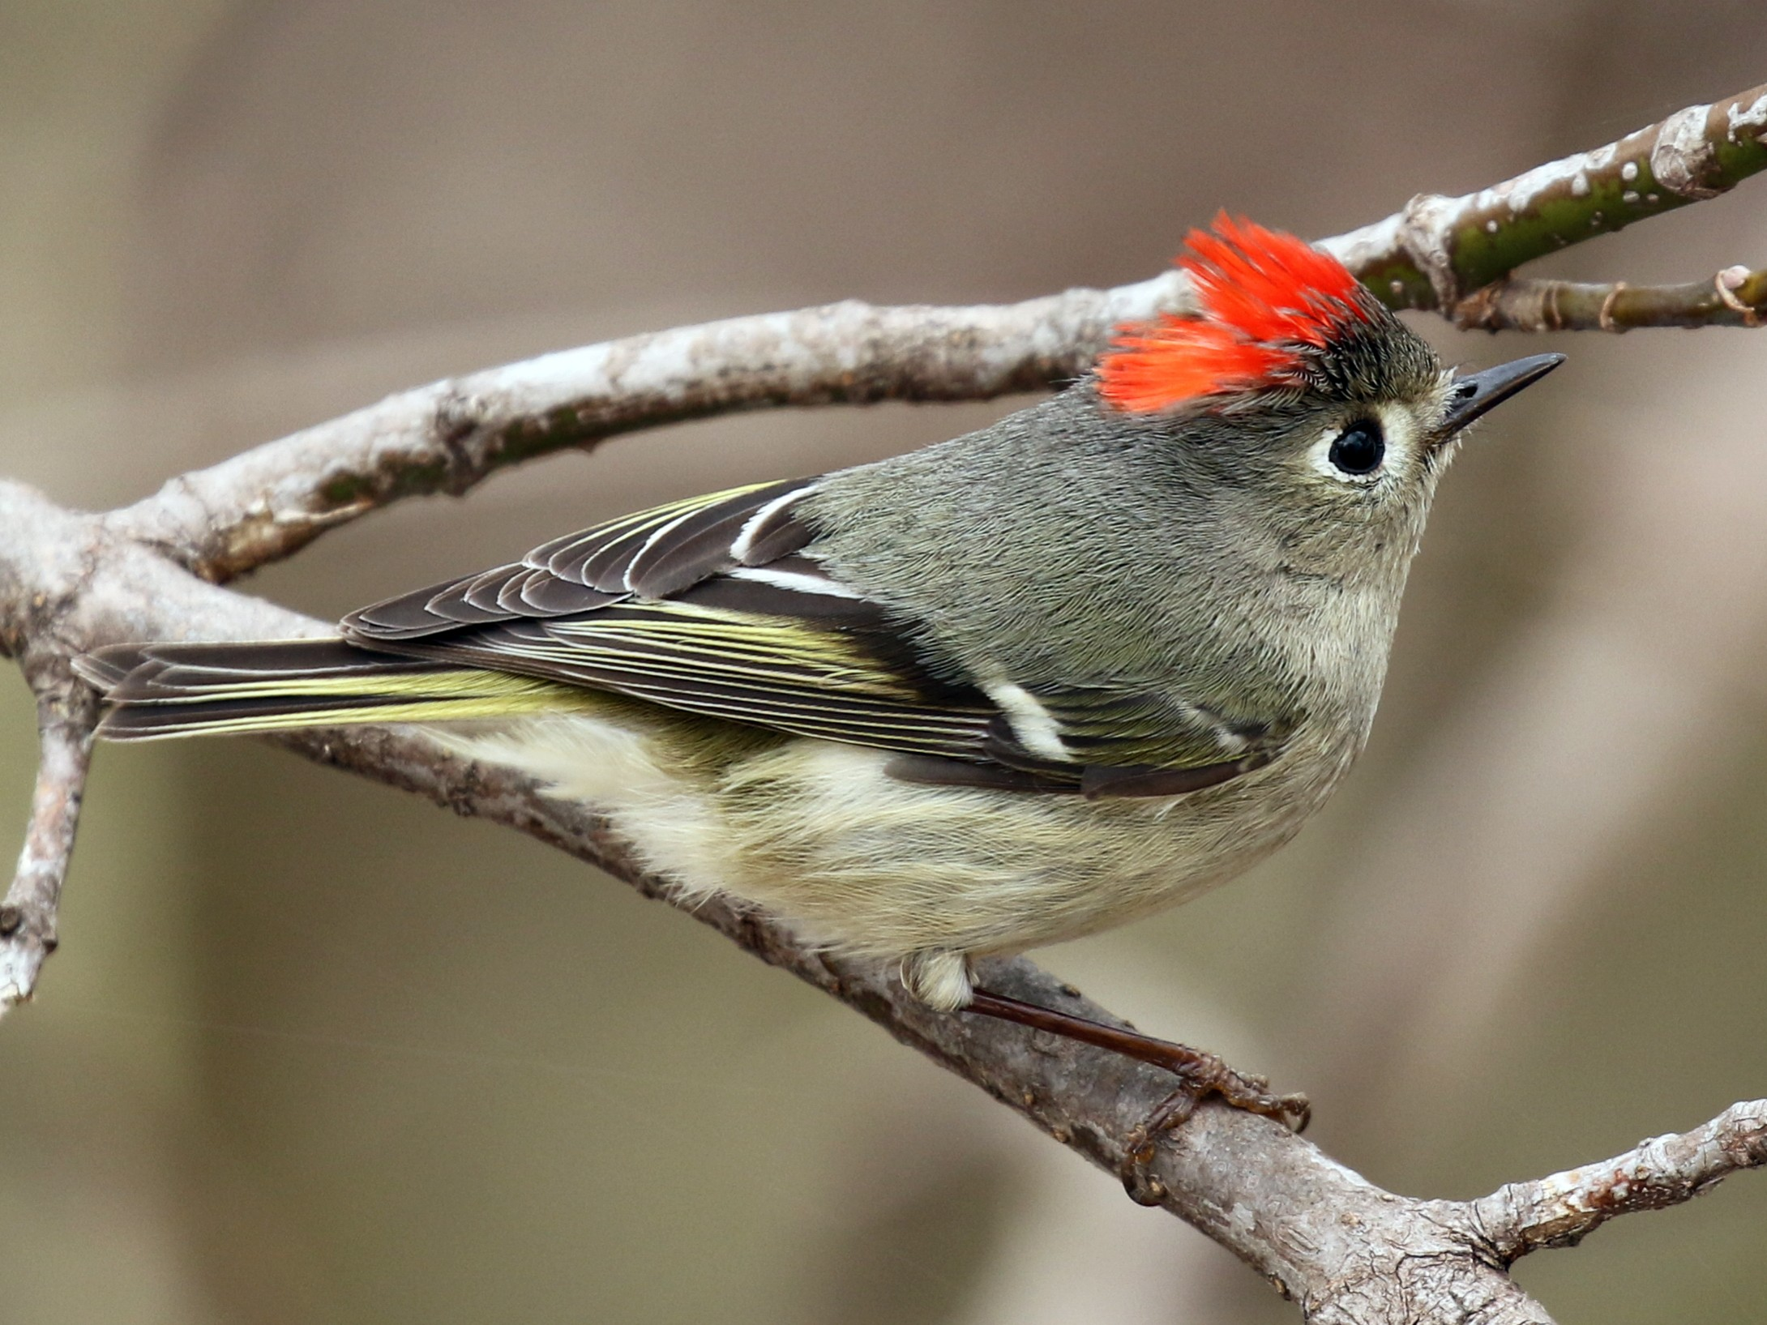
2

Slide 12
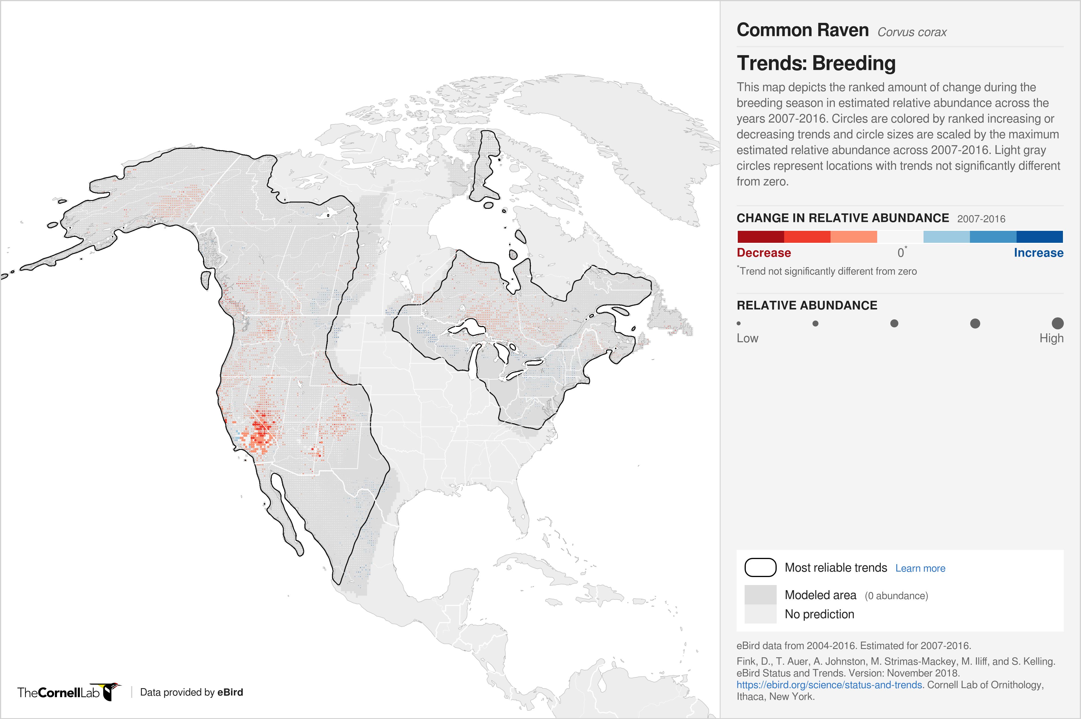
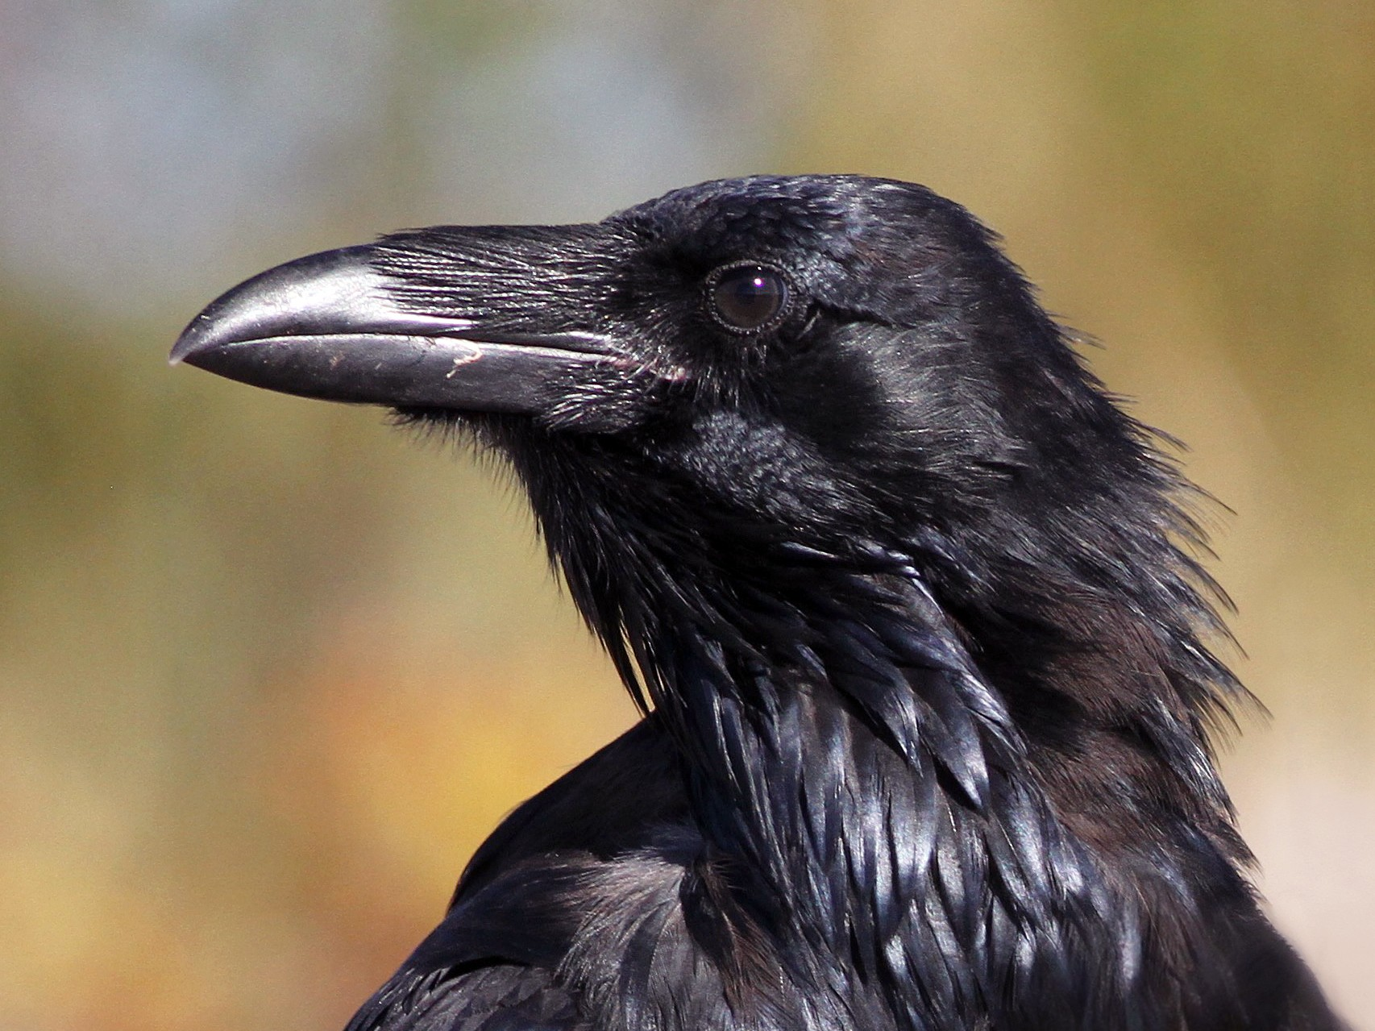
2

Slide 13
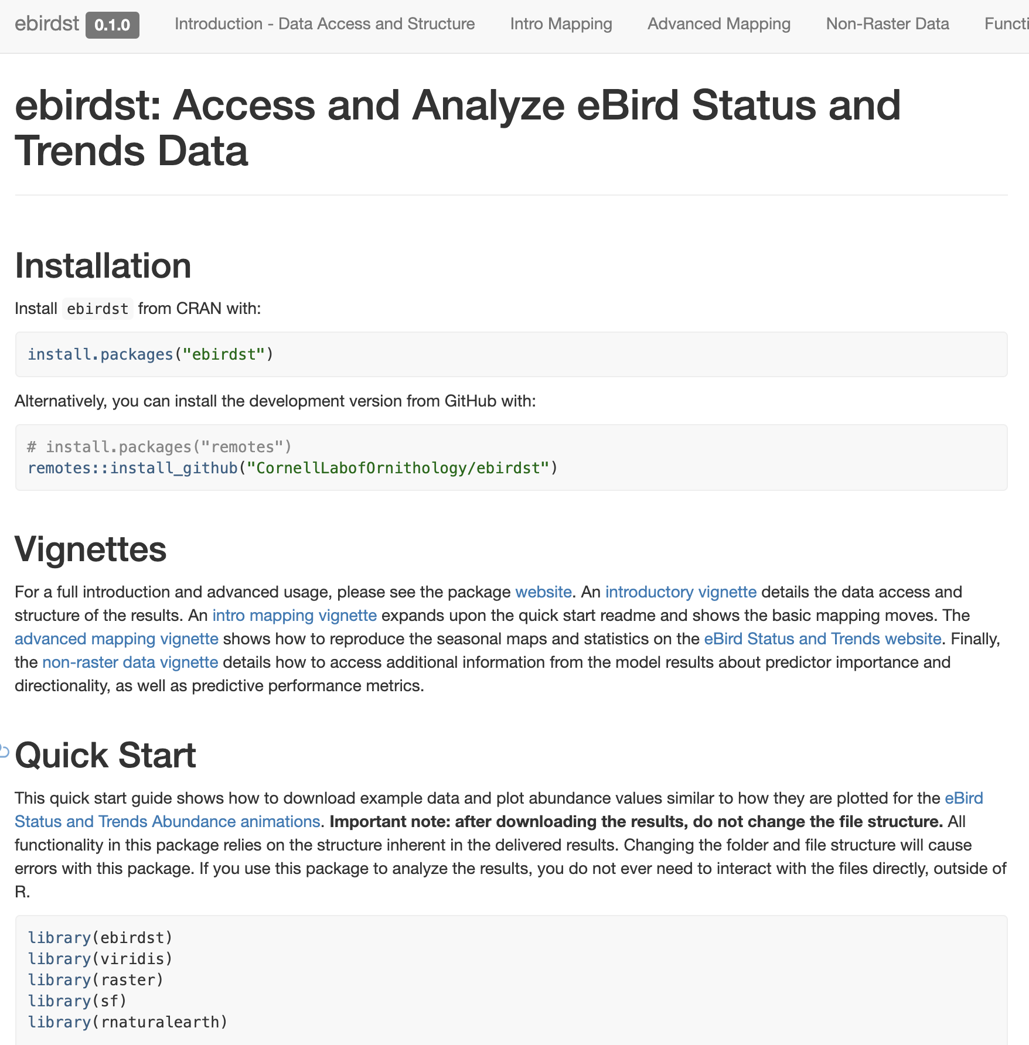
2
Working with eBird Status and Trends data products in R
Tom Auer & Daniel Fink
Friday 12-2 pm
Summit 5-6
Notes:
Data available for 122 species today and over over 500 species by the end of the year

Slide 14

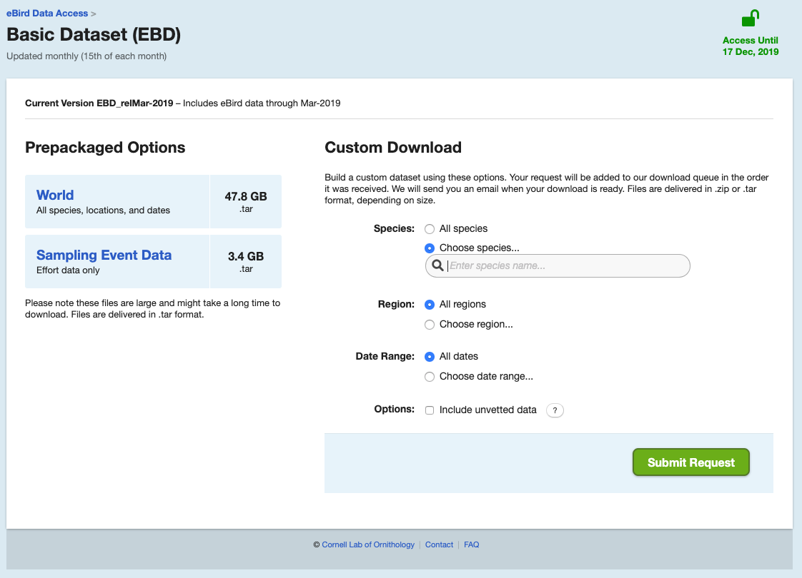
3
!

Slide 15
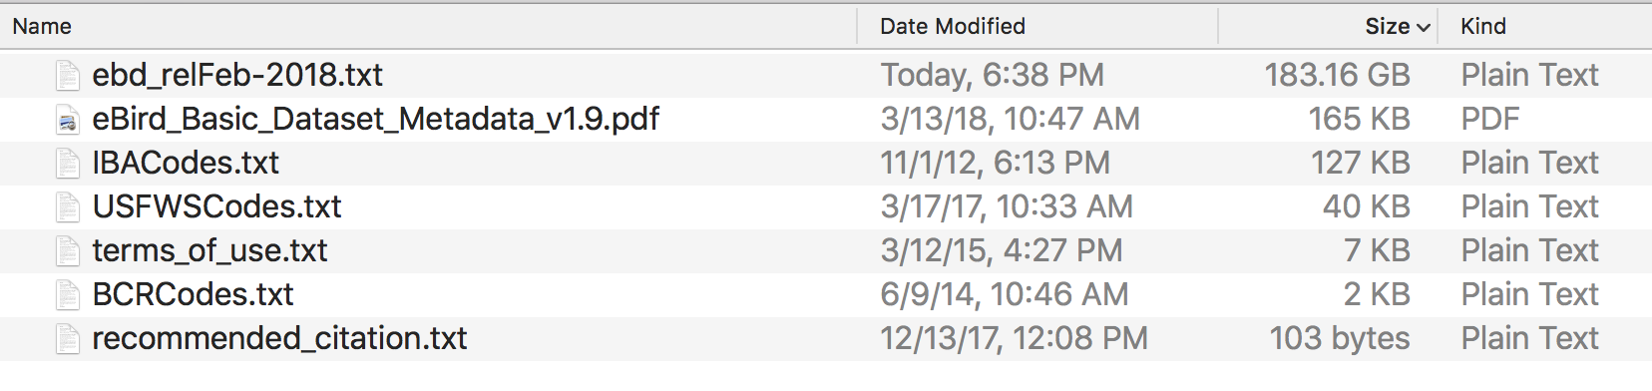
!!!

Slide 16



Slide 17



Slide 18
We need to make this FILE
smaller

Slide 19
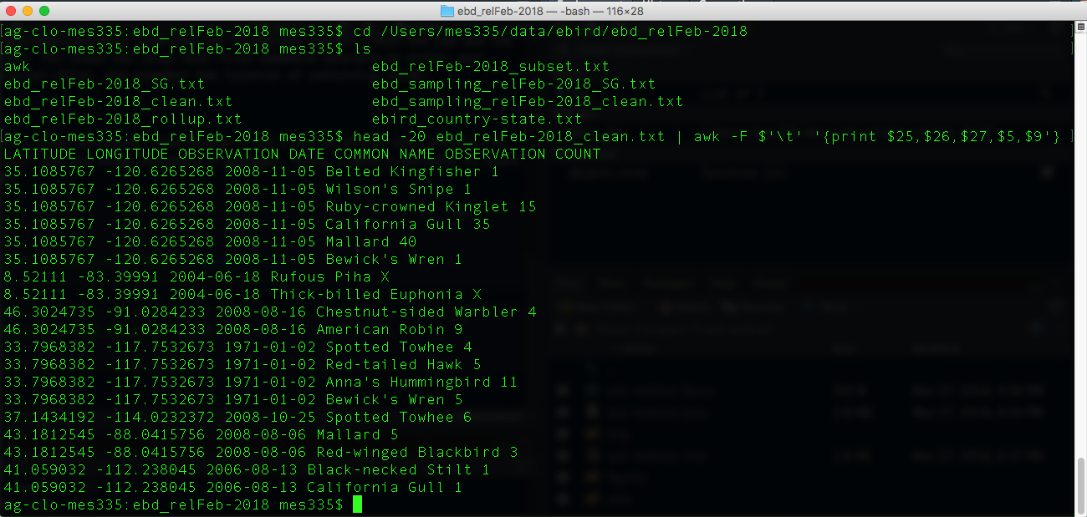

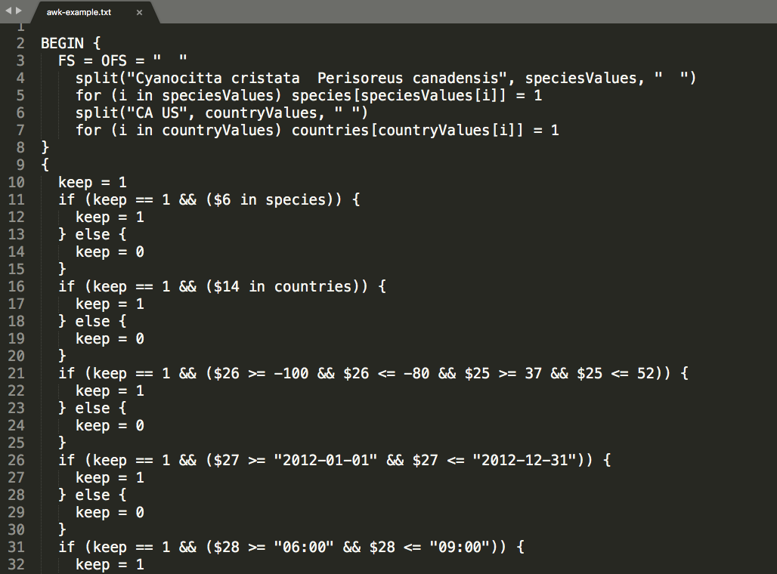

Terminal
AWK

Slide 20
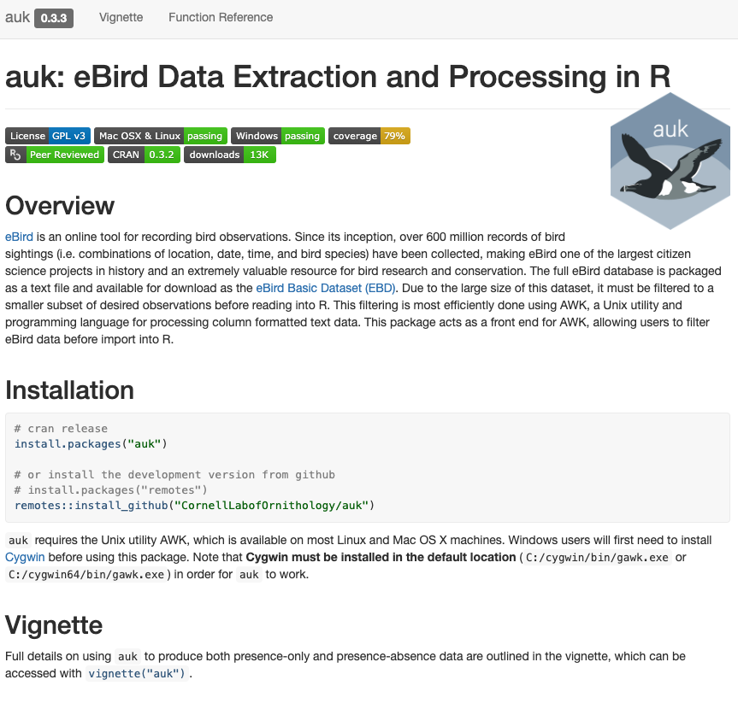
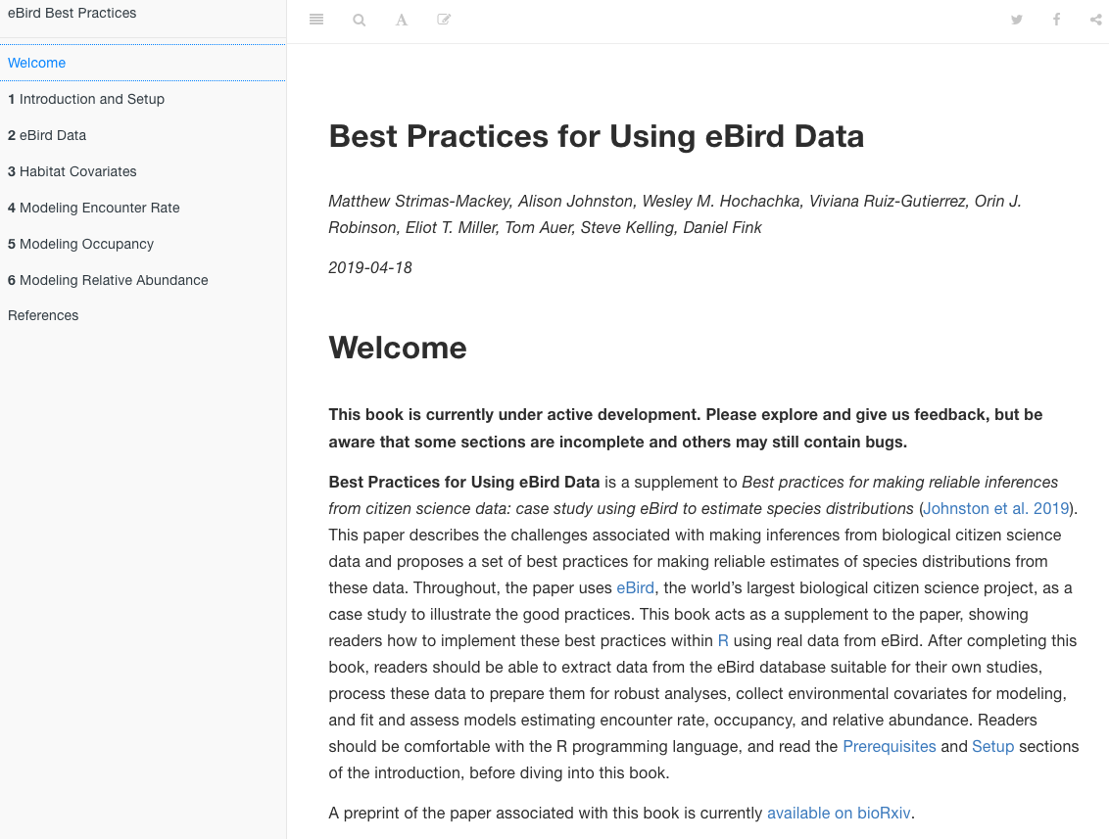

Notes:
All the material from today is in this online book

Slide 21
auk workflow
1
data access
2
filter
3
import
4
pre-process
5
zero-fill

Slide 22
Applications
basic applications
1
occupancy model preparation
2
land cover covariates
3

Slide 23
Workshop format
Participatory live coding
Independent exercises
Tidyverse
Post-it notes

